Slide 1
UFT - Basics

Slide 2
Version Control and Revision History
 | Name | Date
Prepared by | Sneha Kumar | 07-Mar-2019
Reviewed by | Nisha Mendonsa | 07-Mar-2019
Approved by | Gauresh Gaitonde | 08-Mar-2019
Version No. | Date | Affected Sections | Highlights
1.0.0 | 08-Mar-2019 | All | Original Version

Slide 3
Agenda – Session 3 & 4
Output Values
Regular Expression
Batch Test
Recovery Scenarios
Exception Handling
Step Generator
Function definition generator
Transaction
Actions
Virtual Objects
Descriptive Programming-Static & Dynamic

Slide 4
Output Values
Output value can retrieve properties of objects ,database field values, text and can store on data table so that it can be used later in the run session.
Types | Features
Standard Output Values | We can use standard output values to output the properties values of most objects.
Text Output Values | We can use text output values to output text strings displayed on a Web page or application.
Text Area Output Values | We can use text area output values to output text strings displayed within a defined area of a screen in a Windows application.
Database Output Values | We can use database output values to output the value of the contents of database cells, based on the results of a query (result set) that we define on a database.
Xml Output Values | We can use XML output values to output the values of XML elements and attributes in XML documents

Slide 5
Procedure for Standard Output Value:
Scenario :Retrieving the Height property of Ok button
1. Start recording
2. Open flight application-Login
3.Enter Agent Name & Password
3. Go to insert->Output value->standard output value
4. Drag and drop the hand icon on the “OK" Button
5. Check the height property of Output properties.
6. Click OK of Login
7. In flight reservation-open order
8.Provide order number -10
8. Close the application
9. Stop recording
10.Try for parameterization of order number with height property of OK button which is captured.
11. Run the script

Slide 6
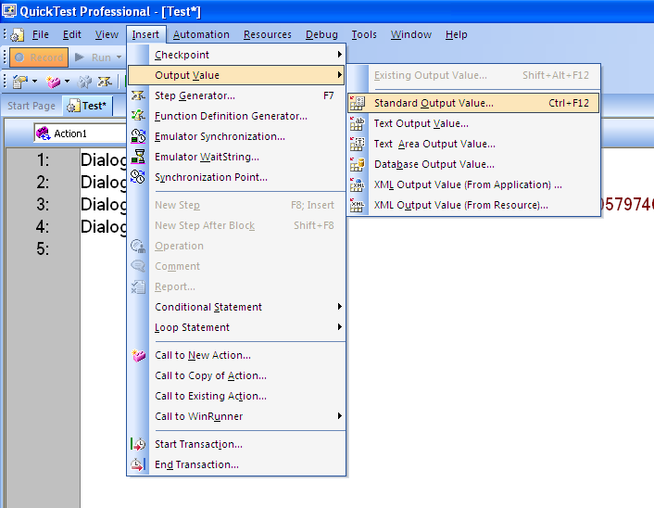
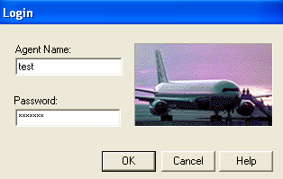
Procedure for Standard Output Value:

Slide 7
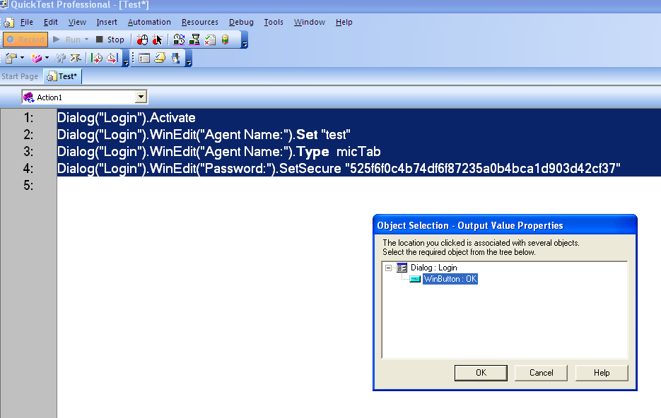
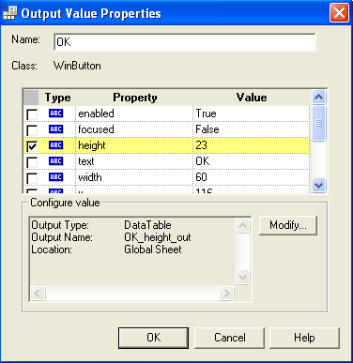
Procedure for Standard Output Value:

Slide 8
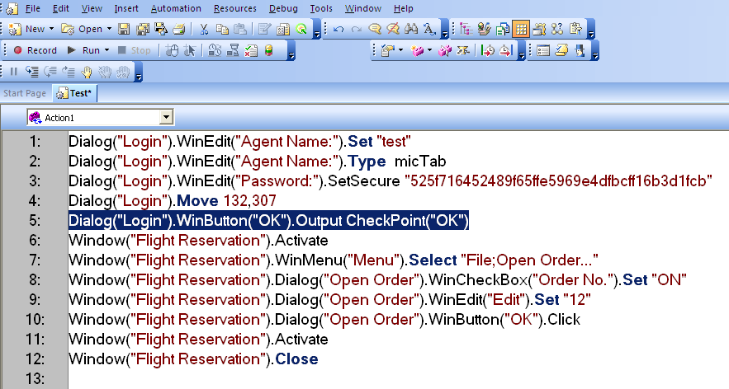
Procedure for Standard Output Value:

Slide 9
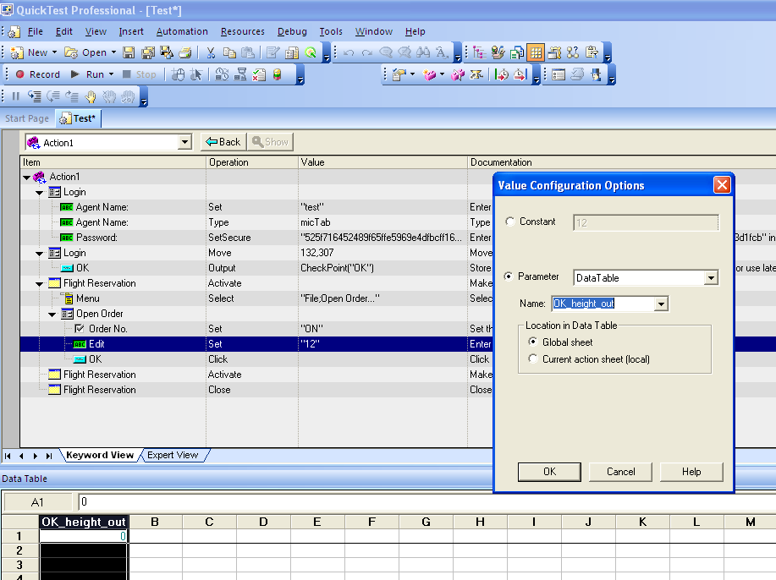
Procedure for Standard Output Value:

Slide 10
Assignments
Validate the number of tickets booked in the graph with respect to the inserted records

Slide 11
Regular Expression
Regular expressions enable Quick Test to identify objects and text strings with varying values.
Purpose:
Defining the property values of an object in dialog boxes or in programmatic descriptions.
Parameterizing a step
Creating checkpoints for varying values.
For example, you can use a regular expression if you want to create a text checkpoint on a date text string, but the displayed date changes according to the current date. If you define the date as a regular expression, the checkpoint checks that the captured text string matches the expected date format, rather than checking the exact date value.

Slide 12
Regular Expression
Format | Explanation
. | Any Character
[xyz] | A character set. Matches any one of the enclosed characters. For example, "[abc]" matches the "a" in "plain".
[^xyz] | Match any character other than the list. A negative character set. Matches any character not enclosed. For example, "[^abc]" matches the "p" in "plain".
[x-y] | Match any single character within the range. A range of characters.For example, "[a-z]" matches any lowercase alphabetic character in the range "a" through "z".
* | Match zero or more specific characters. Matches the preceding character zero or more times. For example, "zo*" matches either "z" or "zoo"
+ | Matches one or more specific characters
? | Match zero or one specific character
^ | Matches beginning of a line
$ | Matches the end of line
\w | Matches non alphabetic character
{} | Matches any number of occurrences A{2} – will match AA A{1,3} – will match A ,AA ,AAA
\d | Match any digit

Slide 13
Procedure for Regular Expression:
1. Start Recording & Open fight application
2. Insert an Order
3. Go to File->Fax Order No
4. Provide Fax Order No and Click Send
5. Close the Application
6. Stop recording
7. Run the test
8. Click Stop in Error Window and open Object Repository
9. Select the Fax Order No. object and select the text property of that object
10. Click the <#> icon and select Regular Expression check box
11. Click Yes to add the backslash before special character
12. Click the arrow icon nearby constant field and select the “open regular expression evaluator” option.
13. Select the Fax Order No. (eg: 21) alone and click the arrow icon and select “\d Any digit”
14. Click Highlight to check the Regular expression
15. If the Regular Expression is not proper, click the arrow icon again and select “+ One or more occurrences”
16. Click Highlight to check the Regular Expression
17. Then close the Regular Expression evaluator & Run the test

Slide 14
Assignments
Check the format of the agent name in Flight reservation
Accept alphabets , numbers , special characters with min 4 characters maximum 10 characters

Slide 15
Batch test
Performing regression testing.
Calling all the script and executing as a batch.
Procedure for Batch Test:
Go to Start->Programs->QTP->Tools->Test Batch Runner
Go to batch->Add(add the scripts that need to be executed for regression test)
Note: Go to Tools-Option-Run-Select the option-Allow other HP product to run the tests & components.

Slide 16
Recovery Scenarios
Recovery Scenarios helps in handling unexpected events, errors, and application crashes during a run time.
A recovery scenario consists of the following: Trigger Event : The event that interrupts your run session. Recovery Operations: The operations to perform to enable QTP to continue running the test after the trigger event interrupts the run session. Post-Recovery Test Run Option: The instructions on how QTP should proceed after the recovery operations have been performed, and from which point in the test QTP should continue.
Save Recovery scenario: Recovery scenario files are saved with extension .qrs. A recovery scenario file is a logical collection of recovery scenarios, grouped according to our specific requirements.

Slide 17
Trigger events
1. Pop-up window: To handle unwanted pop ups.
2. Object state: To handle object related errors at runtime.
3. Test run error: To handle VB script statement errors at runtime.
4. Application crash: To handle crashed applications at runtime.

Slide 18
Exception Handling
When we are able to predict Trigger event occurrence at particular specific point, it is recommended to go with Error Handling.
Following are exception handling statements : 1. On Error Resume Next: On Error Resume Next statement enables the Error handling in the code. If there is error in the code "On error Resume Next" ignores it and continue with next line of code.
2. On Error Go to 0: On error got to 0 statement disables error handling we have previously enabled it by using On Error resume Next.
3. Err.number & Err.description: Provides the error number and the description of the error

Slide 19
Simple program
Function division() On error resume next z=40/0 If err.number <> 0 Then reporter.ReportEvent micWarning, "Error Occured", "Error No & Description is " & err.number & " : " & err.description End If End Function Call division()

Slide 20
Error Handling Vs Recovery Scenarios
If you can predict that a certain event may happen at a specific point in your test or component, it is recommended to handle that event directly within your test or component by adding steps such as If statements or optional steps or "on error resume next", rather than depending on a recovery scenario.
Using Recovery Scenarios may result in unusually slow performance of your tests. They are designed to handle a more generic set of unpredictable events which CANNOT be handled programmatically.

Slide 21
Step Generator
The Step Generator enables you to add steps by selecting from a range of context-sensitive options and entering the required values.
In the Step Generator dialog box you can define steps that use:
test object methods and properties (tests only)
Utility object methods and properties
calls to library functions (tests only), VBScript functions, and internal script functions.

Slide 22
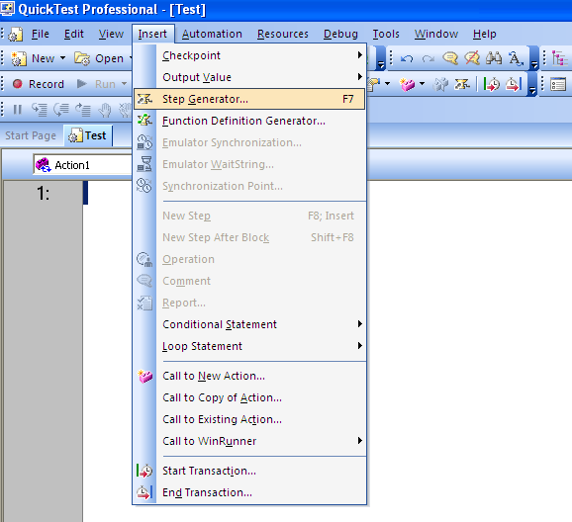
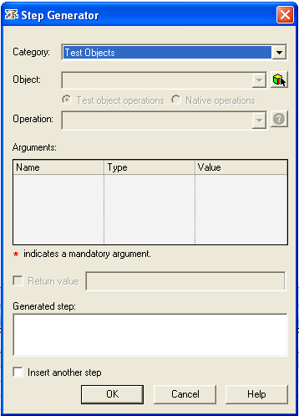
Step Generator

Slide 23
Steps involved in step generator:
Before you open the Step Generator to define a new step, you first select where in your test the new step should be inserted
After you open the Step Generator, you first select the category for the step operation and the required object .Then select the appropriate method or function and define the arguments.
The Step Generator then inserts a step with the correct syntax into your test. You can continue to add further steps at the same location without closing the Step Generator.
You can open the Step Generator from the Keyword View or Expert View while recording or editing your test. You can also open the Step Generator from the Active Screen while editing.

Slide 24
Function Definition Generator
QuickTest provides a Function Definition Generator, which enables you to generate definitions for new user-defined functions and add header information to them.
To use the Function Definition Generator:
Choose Insert > Function Definition Generator
Define the function &Add arguments to the function
Document the function by adding header information to it
Preview the function before finalizing it.
Associate the function to your script from settings.

Slide 25
Transaction
Transaction points can be inserted in script to know the time taken for performing a particular task.
Procedure:
To insert start transaction:
Go to insert->start transaction
Provide some name for the transaction eg: login
To insert end transaction
Go to insert->End transaction
Click ok
Run the script
View the duration in the test result window

Slide 26
Actions
Actions is a set of logical statements to perform specific test.
We can split the script into actions
Action is a collection of VB statements in QTP.
Actions will be saved with .mts
There are three types of actions
Actions | Purpose
Reusable | Actions which can be reused in any script
Non reusable | Actions which cannot be reused in any other script
External | The called actions are referred as External actions in the calling script

Slide 27
Calling actions:
Options on Calling | Procedure
CALL TO NEW ACTION | To create a new action Go to insert->call to New action Provide some name for the action
CALL TO EXISTING ACTION | Using this option we can call the reusable actions in another script Note: 1. Changes made in the main script (where actions are created) will automatically reflect in the calling scripts 2. The called actions will be in read only mode in the calling script (It can't be modified)
CALL TO COPY OF ACTION | Used to get a copy of the already created actions. We can get the copy of both reusable and non reusable actions. Note: 1. Changes made in the main script (where actions are created) will not reflect in the calling scripts 2. The called actions can be modified in calling script (It will be in write mode)

Slide 28
Virtual object
Application under test may contain objects that behave like standard objects but they are not recognized by Quick Test.
You can define these objects as virtual objects and map them to standard classes, such as button or a check box. In the test results, the virtual object is displayed as though it is standard class object
Procedure:
Let us take paint application as an example
1. Open the application window which contains objects (Which need to be made as virtual object) ex: Star tool in the paint
2. Go to tools->new virtual objects
3. Click next
4. From the class combo list choose a appropriate Standard class (Choose based on the behavior of the object) with which we can map the virtual objects
Ex: Select button

Slide 29
Virtual object
5. Click ok
6. Click the "Mark object" button; use the cross hair pointer to provide the boundary for the virtual object
7. Click next
8. click next
9. Provide some name for the virtual object ("Only the provided name will be displayed in the script") ex: Brush
10. Provide some name for the collection eg:”Paint Tools"
11. Click ok
12. Close the paint application
13. Create the script looks as below
Window("Paint").WinObject("Tools").VirtualButton("Brush").Click

Slide 30
Descriptive Programming Language
Without using object repository we are going to do scripting which will reduce the memory as well as Execution time.
Object Spy is used to get the properties and their values to uniquely identify the objects in the application. If we know such properties and their unique values that can identify the required object without ambiguity, we need not use Object Spy.
In descriptive programming we have two types
1. Static
2. Dynamic

Slide 31
Guidelines for static programming language
Structure of the script is
Standardclass("Property1:=value1").method
Note:
If one property is not sufficient to uniquely identify the object then provide more than one property value pair
Structure of the script is
Standardclass ("Property1:=value1","property2:=value2","propertyn:=valuen").method
Example:
Dialog ("text: =Login","nativeclass: =Dialog").activate

Slide 32
Static Descriptive program
Script for login process:
SystemUtil.Run "C:\Program Files\HP\QuickTest Professional\samples\flight\app\flight4a.exe","","C:\Program Files\HP\QuickTest Professional\samples\flight\app\","open"
Dialog("text:=Login").Activate
Dialog("text:=Login").WinEdit("attached text:=Agent Name :").Set “Testing"
Dialog("text: =Login").WinEdit("attached text:=Password :") .SetSecure "mercury"
Dialog("text: =Login").WinButton("text:=OK").Click

Slide 33
Dynamic Descriptive program
Script for login process:
Dim a,b,c,d
Set a=description.Create
a("text").value="Login"
Set b=description.Create
b("attached text").value="Agent Name:"
Set c=description.Create
c("attached text").value="Password:"
Set d=description.Create
d("text").value="OK"
Dialog(a).Activate
Dialog(a).WinEdit(b).Set "qwerty"
Dialog(a).WinEdit(c).SetSecure "mercury"
Dialog(a).WinButton(d).Click

Slide 34
Circumstance to use Descriptive Programming
Scenario | Circumstances | Drawbacks with OR
Scenario 1 | Suppose we need to start Automation before Build Release. | There is no application to create Object Repository
Scenario 2 | If the Application under test is having Dynamic Objects. | Difficult to handle Dynamic Objects using Object Repository
Scenario 3 | When the application under Test is having objects that are adding in the Run Time | We can’t add objects to Object Repository in run time.
Scenario 4 | If Application under test is having similar type of objects or similar name objects. | Object Repository will create multiple objects with same description unnecessarily.
Scenario 5 | When Application under test have more objects to perform operations. | The performance will decrease if object repository is having huge number of objects.

Slide 35
Advantages of Descriptive Programming:
1. Version Free: Script can be executed in any version of QTP without any changes. 2. Code Portability: Just code is enough to run script. We can copy and paste in other scripts for any other new requirement. 3. Reusability of Properties: We can assign properties to a global variable and reuse it for same type of objects. 4. Plug & Play: Any time scripts will be in ready to run state. No need to worry about any other settings or files. 5. Just Maintenance of variables: Store the object properties in the form of variables in a txt / vbs file, need to maintain the file.

Slide 36
Assignments
Create a descriptive programming for booking a ticket in the flight reservation application
Create a descriptive programming for the Syntelligence Login window

Slide 37
References
http://www.advancedqtp.com
http://www.gcreddy.com
www.qtpschool.com
www.qtpworld.com

